Slide 1
AI-Driven Mobile Applications Proposal by: Layana – Tracy – Omar Abbas – Abbas – Omar Jaber

Slide 2
Calorie Counter App

Slide 3
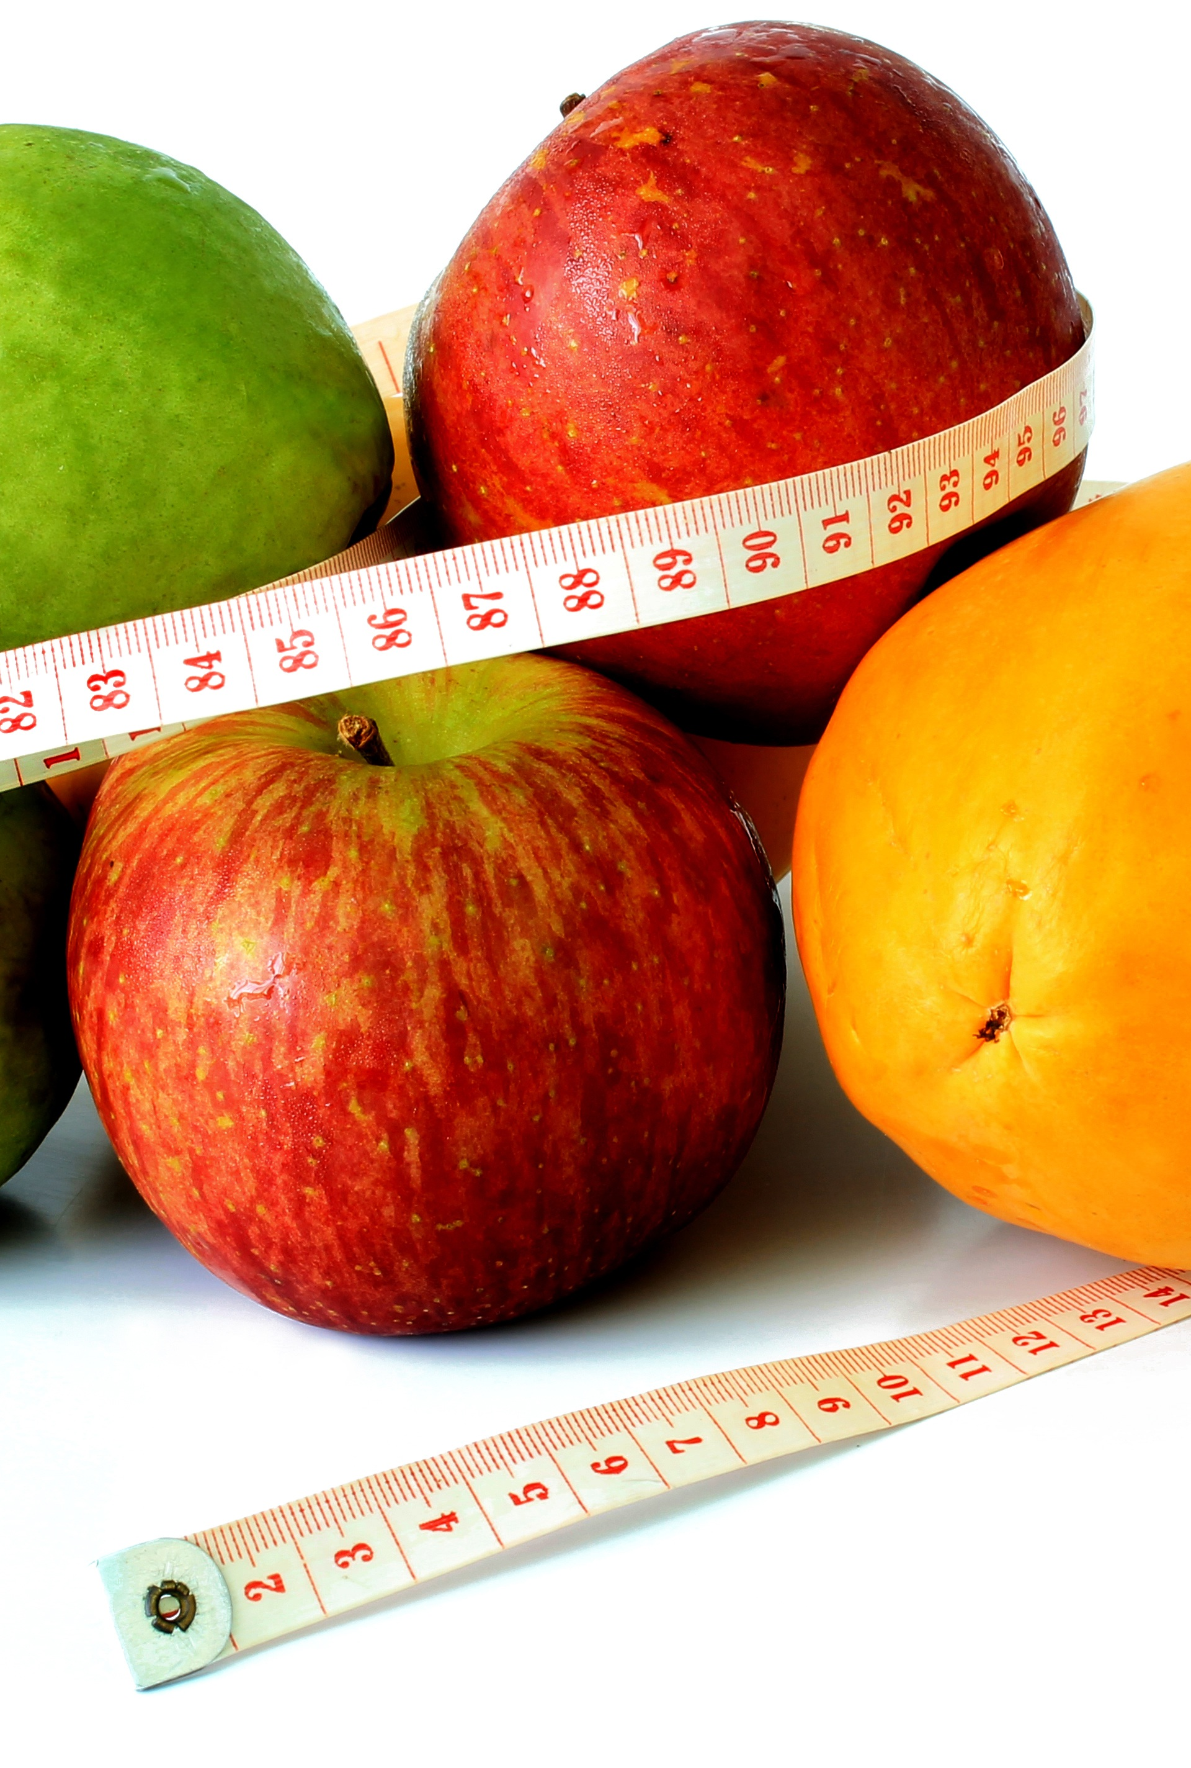
Aim:
Helps users track their calorie intake by taking pictures of their meals.
By utilizing advanced computer vision technology, the app will provide accurate calorie estimations and nutritional insights, empowering users to manage their health and achieve their fitness goals more effectively.

Slide 4
Basic Functionalities
Use computer vision to analyze images of food and estimate calorie content.
User input for manual adjustments.
Daily/weekly calorie tracking and progress visualization.
Recommendations for healthier alternatives.

Slide 5
Screen design using figma
Camera Interface: Simple capture button and image preview for easy meal logging. Figma: Vector tools for icons, frame layout.
Calorie Log: Displays logged meals with date, time, and calorie count for tracking.
Figma: Auto Layout for entries, component reuse.
Analytics Dashboard: Visual graphs to show calorie consumption trends over time.
Figma: Graph plugins, lay-out contraints.

Slide 6
AI Technology Utilized
Computer Vision:
The app employs advanced computer vision algorithms to analyze food images accurately. This technology identifies food items and estimates calorie content based on visual features.
Data Processing:
AI processes user inputs and logged meals to refine accuracy over time, learning from user behavior to improve future estimations.
User Experience Enhancement:
The integration of AI provides a seamless user experience by quickly analyzing images and presenting data without requiring extensive user input.

Slide 7
Personalized Study Assistant

Slide 8

Aim:
To help students manage their study schedules effectively and improve learning efficiency by tailoring study plans to individual habits and needs.
To provide timely reminders and resources that enhance academic performance and keep students organized throughout their study journey.

Slide 9
Basic Functionalities
AI analyzes user study habits to create personalized study plans.
Users can set specific subjects and topics for focused learning.
Provides reminders for upcoming deadlines and exams to ensure timely preparation.
Suggests tailored resources such as videos, articles, and practice quizzes based on user learning styles.
Tracks progress over time, allowing users to review their study patterns and make adjustments as needed.

Slide 10
Screen design using figma
Study Plan Interface: Simple layout displaying customized study schedules with subjects and time allocations for efficient planning.
Figma: Auto Layout for organizing study entries, vector tools for creating intuitive icons.
Reminder Notifications: Clear alerts showing upcoming deadlines and exams to keep users on track.
Figma: Component reuse for notification elements, constraints for responsive design.
Progress Tracker: Visual representation of study progress, allowing users to review completed tasks and remaining study goals.
Figma: Graph plugins for creating progress charts, layout constraints for data visualization.

Slide 11
AI Technology Utilization
Data Analysis: The app uses AI to analyze user study patterns, identifying strengths and weaknesses to create effective study plans tailored to individual learning needs.
Adaptive Learning: AI adapts study plans in real time based on user input and changing study habits, ensuring that the learning experience evolves with the user. Progress Tracking: The app employs machine learning to monitor progress and provide insights into study effectiveness, helping users optimize their learning strategies. User Interaction: AI enhances user interaction by automating reminders and notifications, making it easier for students to stay organized and engaged with their studies.

Slide 12
Thank you
☺

